Slide 1
Decoding the sensation of pain from brain signals
Thomas Sadler
2101179
Supervisor: Dr Sebastian Halder
School of Computer Science and Electronic Engineering University of Essex

Slide 2
Pain is a term used loosely to describe a feeling of un-comfortability
When we experience pain, our brain exerts brain signals via synapses that contain information pertinent to the pain we are feeling
If we only had these brain signals, how could we figure out whether someone was in pain?
Context 1.1

Slide 3
Context 1.2
There are two main ways we can try to:
Which regions of the brain / scalp are responsible for the brain signals that are most pertinent when experiencing pain?
What information inside these brain signals can we find that would make our job of classifying whether someone is in a pain state easier.
The overarching goal is to be able to classify between a pain and non-pain state
Pre-processing → Feature Extraction → Classification → Evaluation of results

Slide 4
The data
EEG
Pre-processing
Frequency filtering
Independent component analysis
Epoching
Feature Extraction
Event analysis
Predicting regions of interest
Data classification
Chosen models
Classification results
Result findings
Improvements and further work
Contents

Slide 5
The data
Provided to me by my supervisor, used in a previous project regarding tonic pain
The data contains information for 36 participant: 22 females, 14 males (range of ethnicities)
During these experiments, five different experimental events occur. Two of which occur twice. These are:
1. Eyes open state (One at the start and one at the end)
2. Eyes closed state (One at the start and one at the end)
3. Warm water emersion
4. Hot water emersion
5. Uncomfortable sound stimuli (Is ignored in this project)
So, we need to classify between Eyes open vs Eyes closed (difference is not so subtle).
Then we can attempt to classify between Warm water emersion (non-pain state) and Hot water emersion (pain state).

Slide 6
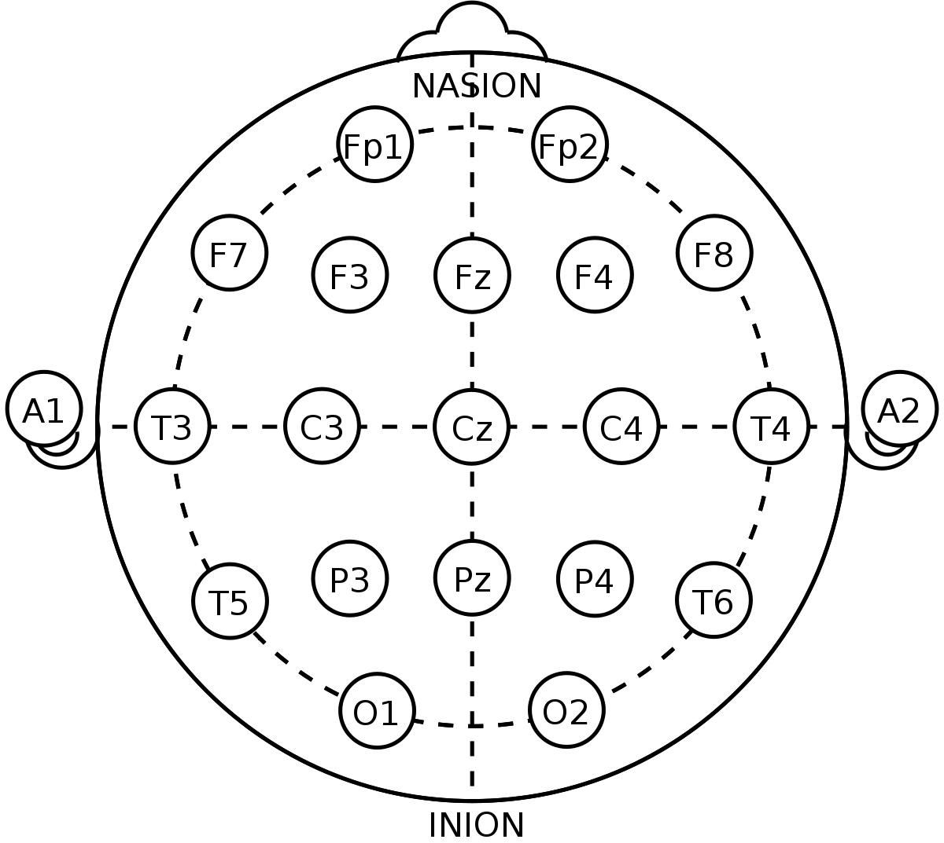
EEG
Data was captured using an electroencephalogram
Small metal disks referred to as electrodes are fitted to the participant's scalp.
The electrodes are connected via wires to an amplifier which amplifies the brain
Waves.
Each one these electrodes is known as a channel.
Channel FP1 refers to the electrode on the frontal portion of the scalp on the left
For our data we had 63 channels / electrodes in total.

Slide 7
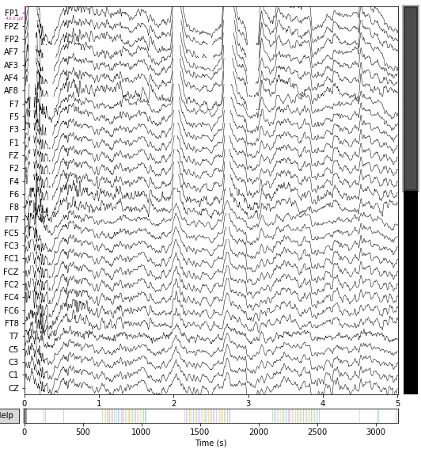
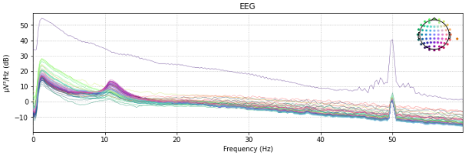
Data at first glance
Power spectral density plot
Measure of a signals power against their frequency.
We can see an obvious broken electrode
Line interference at the 50Hz marker.
Data in it’s most raw form
channels labelled on the left
We can already see some noisy components forming.

Slide 8
Signals are susceptible to slow-drift
Low frequency slow-drifts refers to the gradual change in output value without internal change
Upwards slow drifts increase the value of noisy components
This makes it harder for ICA to find an accurate solution and isolate them
We implement a high pass filter to combat this (1Hz)
Frequency filtering

Slide 9
When reading brain signals, we capture a lot of information. A lot of the information we capture is not relevant to our task.
ICA algorithm sweeps over our signal and tries to isolate noisy artifacts
We can choose whether to remove them.
Deciding whether an artifact is removeable is considered “an art” to a lot of data scientists.
The worst thing we can do is remove an artifact that the ICA thinks is a noisy artifact, but it is in fact useful brain signal.
Here are some examples of how to recognize removable components
Independent Component Analysis

Slide 10
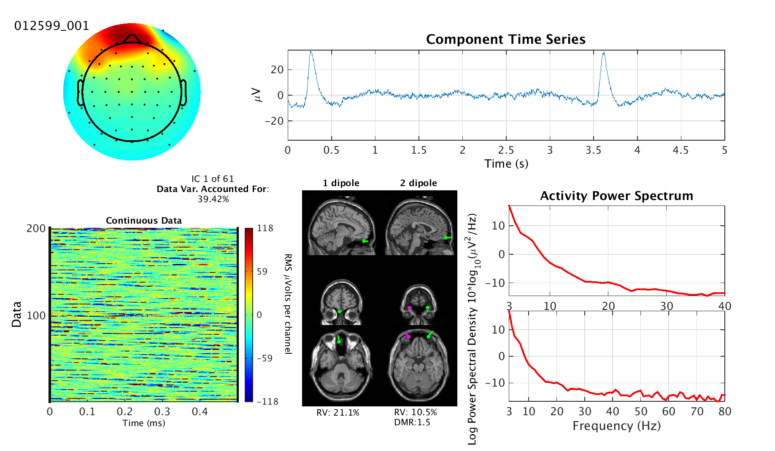
Eye Component
Anterior topographical weight distribution
Power Concentrated at low frequencies (Usually below 5Hz)
Fairly obvious blinks in the time series plot

Slide 11
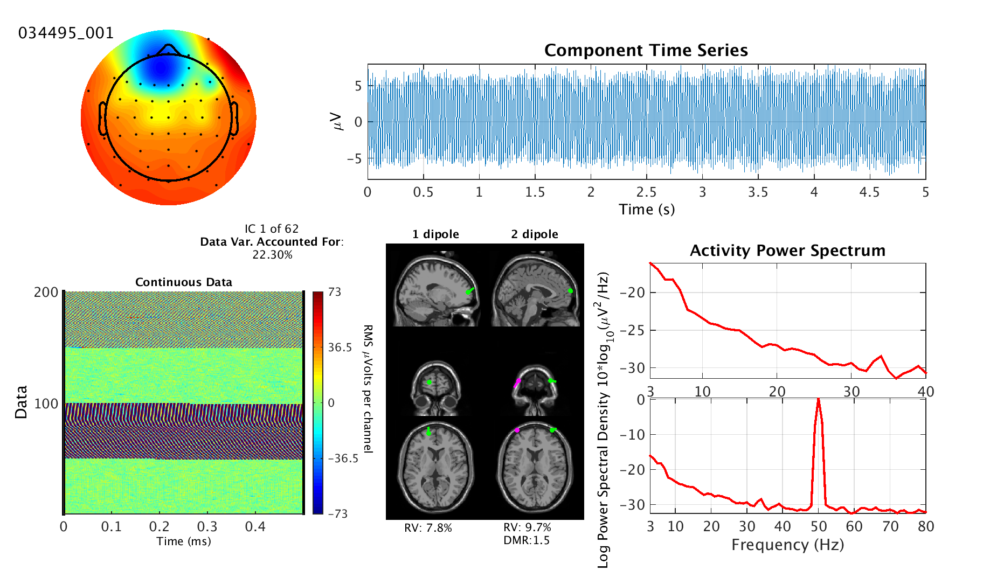
Line Noise
Power grid functions at 50Hz
Any electrical device operating at 50Hz be recorded as line noise
Doesn’t matter too much unless we require the useful information at 50Hz

Slide 12
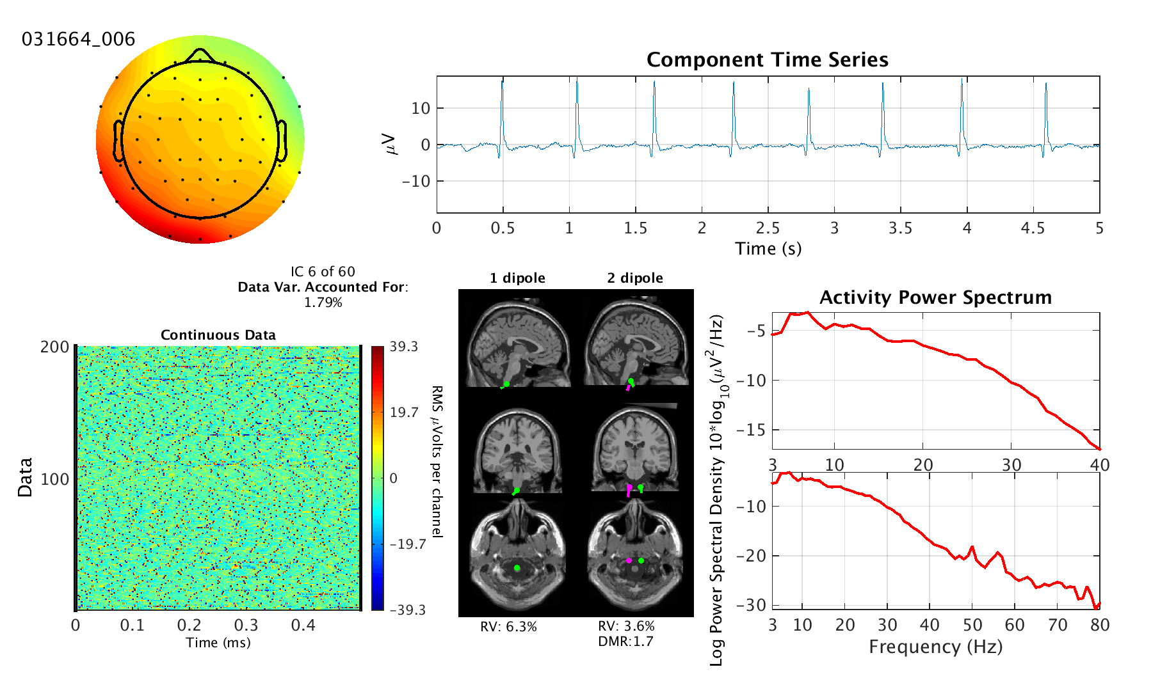
Heart Component
Time series plot shows an obvious QRS complex at 1Hz

Slide 13
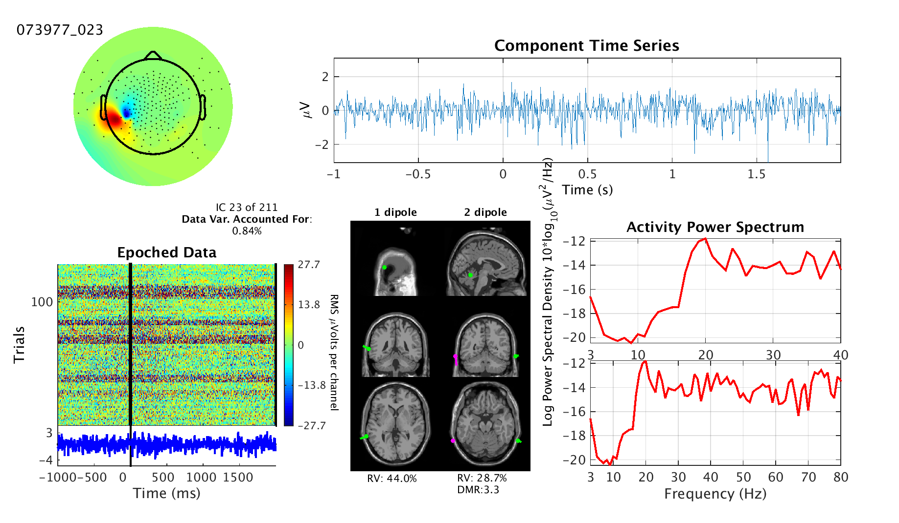
Muscle Component
Power concentrated in higher frequencies (20Hz and above)
Immediate high peaks in the power spectrum before taking the 1/f shape

Slide 14

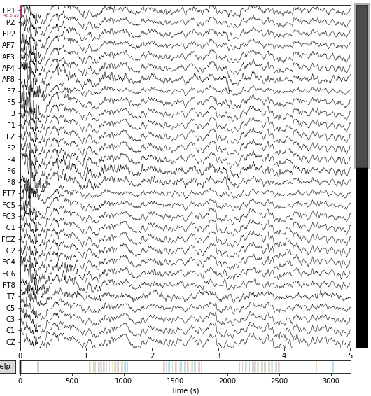
ICA before and after

Slide 15
Epoching
Now we need to segment the part of the signals that are only relevant to experimental events.
This is what’s called epoching (Done using the event time markers)
When we have epoched our useful segments of the signal
We need to epoch the epochs again using regular time intervals
Essentially the transformation is channels x samples → trials x channels x samples
Each one of these trails will act as a single row in our data frame that is passed to the classifier

Slide 16
Epoching Visualization

Slide 17
Feature extraction
Features used in this project are power spectral densities.
There’ve been lots of papers (referenced in my thesis) that can attest to how good power spectral densities are for signal classification. They are very “individual”
Wave signals can be decomposed into its different frequency bands. These are parametrized by upper and lower frequency bounds.
Delta: 0.5-4
Theta: 4-8
Alpha: 8-12
Beta: 12-30
Gamma: 35+
The power of these frequencies increase and decrease for different human activities and can once again be used to differentiate between experimental events
For example, we already know that when your eyes are closed, you have increase Alpha

Slide 18
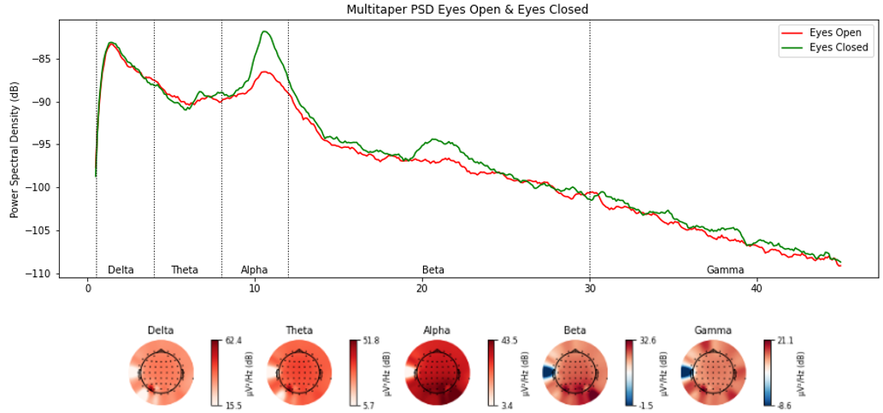
Eyes open vs Eyes Closed
We can clearly see the increased alpha during eyes closed.
Other than Beta, there are no obvious discrepancies in the other bands

Slide 19
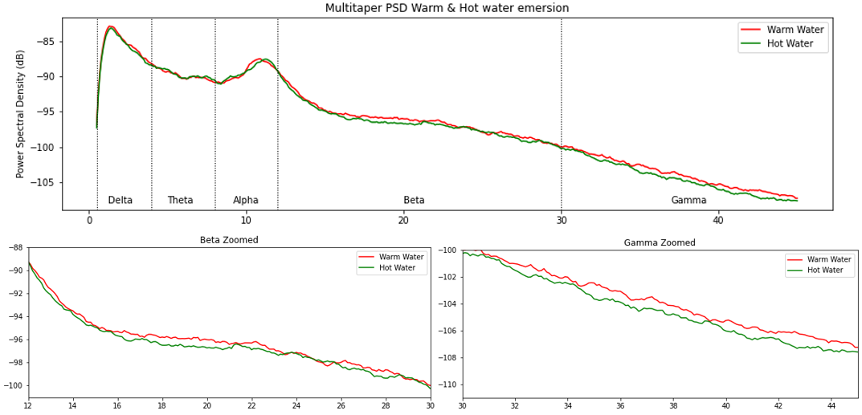
Hot water vs Warm Water
This proves how subtle the difference is between the pain and non pain state.
There are no obvious discrepancies that we can use however if we zoom in.
There may be something in the Beta and Gamma bands.

Slide 20
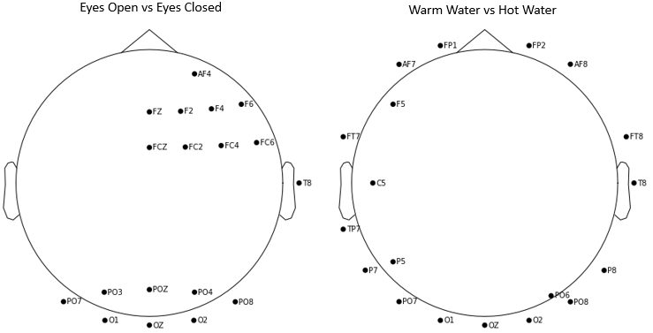
Channel selection predictions
We are using channel selectors such as SPoC and Common Spatial patterns
When classifying these models find a combination of our 63 channels / electrodes that contain the most useful information
We can try and predict what these are.
By finding the differences between power spectral densities between two experimental events, we can plot the top 8-15 channels
The biggest differences will make distinguishing between experimental events easiest.

Slide 21
Data classification
We are classifying using three different pipelines and comparing them:
Common spatial patterns and Support vector machine
Source power comodulation and support vector machine
Riemannian geometry and support vector machine
Chosen due to their common presence in the literature or their unexplored potential

Slide 22
Results
Eyes Open vs Eyes Closed
 | Riemannian | CSP | SPoC
Best | 100% | 100% | 100%
Worst | 95% | 76.7% | 66.7%
Average | 99.1% | 94.2% | 85.7%
Warm water vs Hot Water
 | Riemannian | CSP | SPoC
Best | 100% | 100% | 100%
Worst | 92.3% | 43.9% | 56.9%
Average | 97.6% | 81.8% | 75.1%

Slide 23
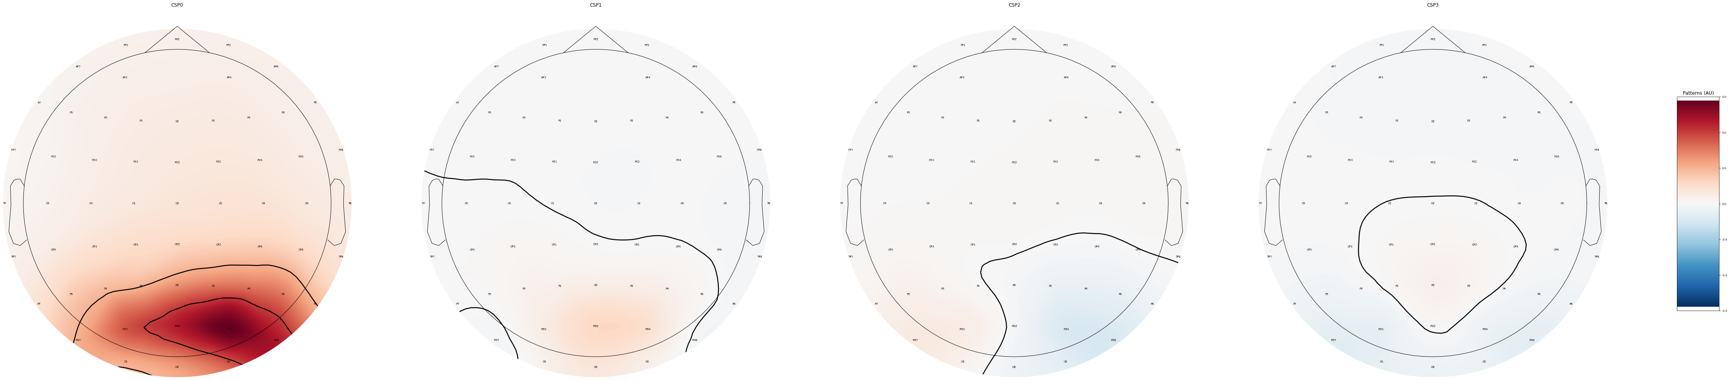
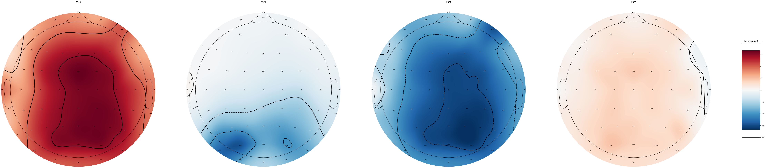
Regions of Interest
Now that we have a trained models, we can find out whereabout they got they most important information
Eyes Open vs Eyes Closed
Warm water vs Hot Water

Slide 24
Results by frequency band
Riemannian
 | Delta | Theta | Alpha | Beta | Gamma
Best | 98.6% | 95% | 96.9% | 100% | 100%
Worst | 62% | 47.3% | 56.6% | 73.8% | 65.7%
Average | 77.4% | 72.5% | 73.1% | 91.4% | 89.2%
These results were calculated across Hot water vs warm water only.
Clearly the best performing frequency bands are Beta and Gamma
This corroborates some of the findings made earlier in the project
Common Spatial Patterns (CSP)
 | Delta | Theta | Alpha | Beta | Gamma
Best | 100% | 100% | 100% | 100% | 100%
Worst | 51.4% | 52.1% | 58.3% | 54.3% | 46.7%
Average | 79.4% | 77.7% | 75.6% | 85.1% | 83.6%
Source power comodulation (SPoC)
 | Delta | Theta | Alpha | Beta | Gamma
Best | 93% | 100% | 100% | 100% | 100%
Worst | 41.7% | 42.7% | 53.5% | 52.1% | 56.7%
Average | 69.3% | 72.2% | 69.4% | 81.3% | 80,%

Slide 25
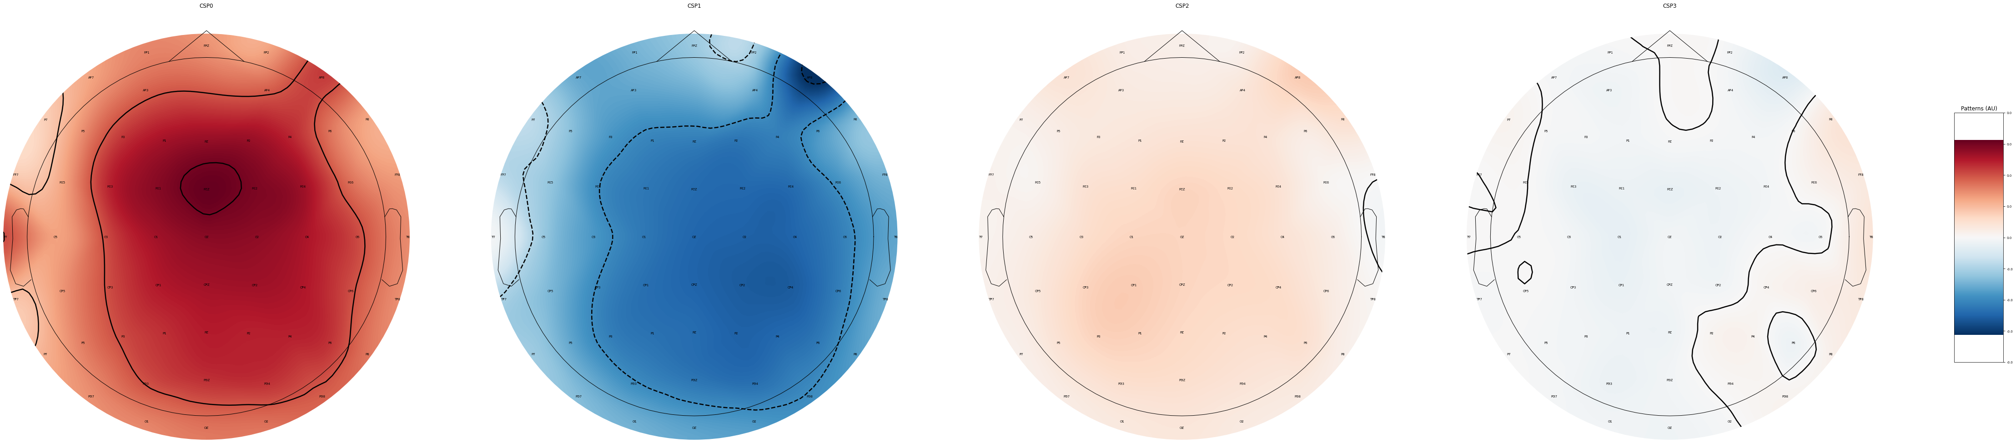
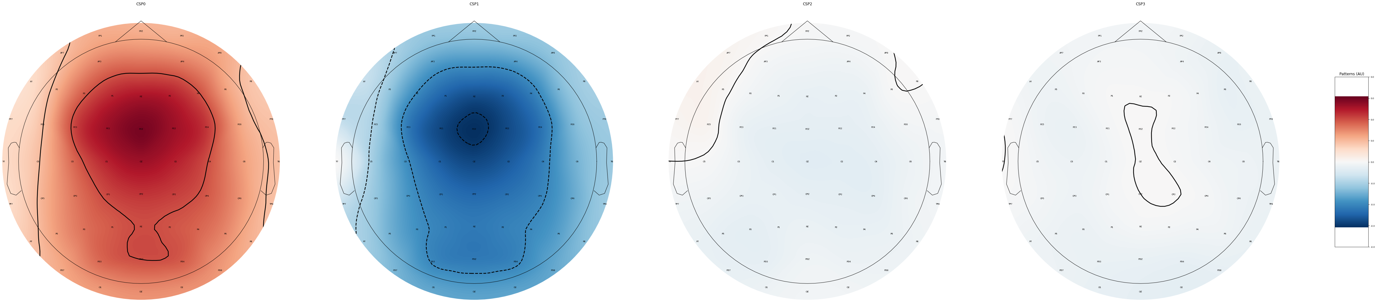
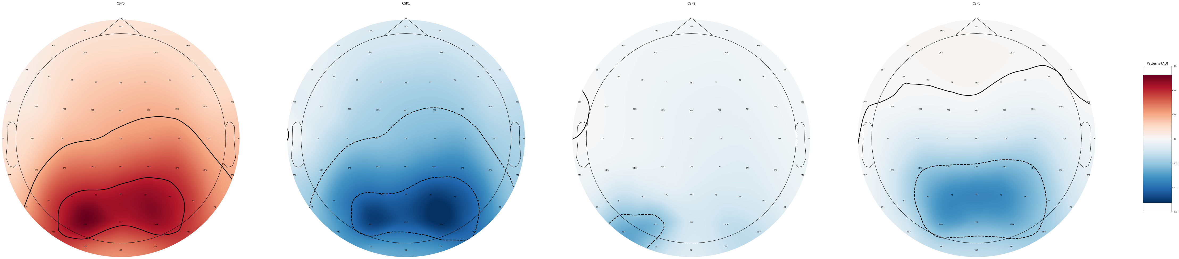
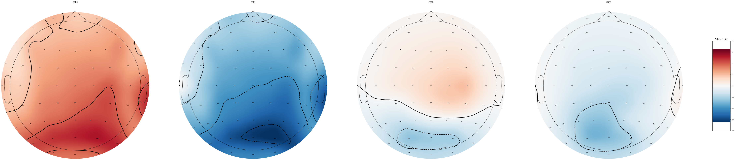
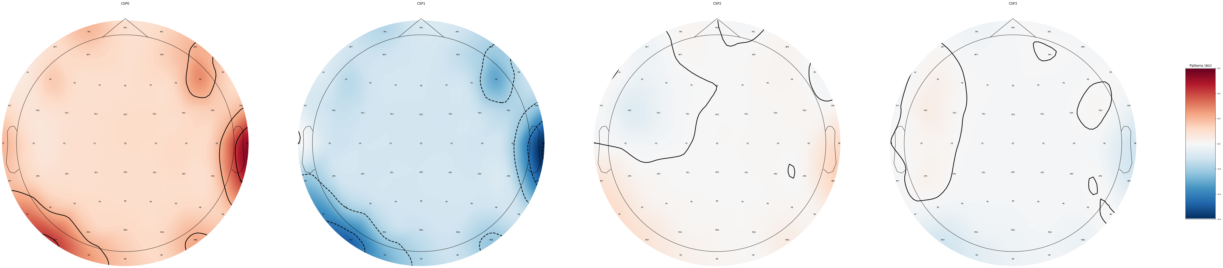
Regions of Interest by frequency band
Same as before except we can look at where specific frequency band trained models, get their information
Delta
Theta
Alpha
Beta
Gamma

Slide 26
Improvements
The pipeline is fairly manual and could be improved with the introduction of AAR
The channels that have been taken out should be interpolated to their nearest neighbor
The epoch segmentation time can be lowered so we have more trials to train our models with

Slide 27
Demonstration
Unfortunately, I can’t run it live for you as it takes several minutes for a single invocation.
However, the outputs for a compilation in Jupyter notebook are already loaded.
Therefore, I will scroll through my entire program script and run you through what everything does, and what it outputs.

Slide 28

Thank you very much for listening! Special thanks to my supervisor Dr Sebastian Halder for the continuous support and answering of any and all questions that were given.

